Slide 1
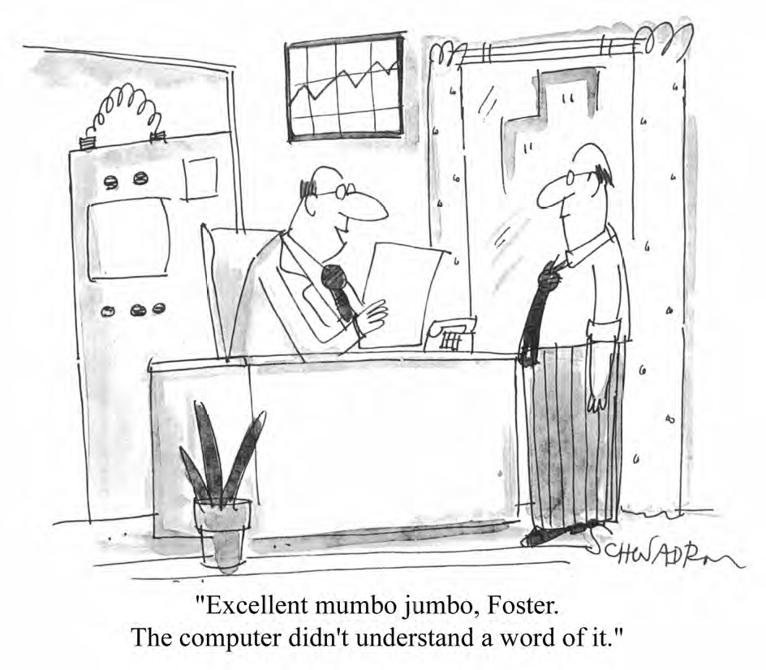
Intro to
Plain Language
Delivered by Rachel Mills
May 2026

Slide 2
What is plain language?
A communication is in plain language if its wording, structure, and design are so clear that the intended audience can easily find what they need, understand what they find, and use that information.
- Plain Language Association International

Slide 3
Did you know Canada has a Standard on plain language?
In October 2025, Canada published its first National Standard on Plain Language.
We were part of the technical committee that shaped this standard.
You can find the standard online: CAN-ASC-3.1:2025 – Plain Language
Notes:
https://accessible.canada.ca/creating-accessibility-standards/can-asc-312025-plain-language

Slide 4
Who benefits from plain language?
Everyone
people who are in a hurry (employers, educators, medical & legal professionals)
language learners
people with low literacy
people with disabilities

Slide 5
How do I know if my communication is in plain language?
Only the intended audience can say if the wording, structure, and design of your communication are so clear that they can easily find what they need, understand what they find, and use that information.
Testing your communication with your intended audience is the only way to make sure that your communication is in plain language.

Slide 6
Steps to using plain language
Identify your intended audience and purpose
Structure and organize your information
Write using plain language
Design to support understanding and usability
Test and revise the design and content

Slide 7
Writing Tips

Slide 8
Words
Choose the simplest, shortest word that is familiar to your audience
(1 or 2 syllables, where possible)
For example:
  Replace ‘demonstrate’ with ‘show’
  Replace ‘accomplish’ with ‘do’
  Replace ‘disseminate’ with ‘send’

Slide 9
Words
Use simple conjunctions
Conjunction = a word used to connect clauses or sentences or to coordinate words in the same clause (a joining word).
For example:
  for
  and
  but
  or
  so

Slide 10
Words
Delete filler words
Remove unnecessary details
For example:
“Please submit your application no later than April 30, 2022.”
“The letter is in regard to your job application.”
“I appreciate the manner in which you handled that.”

Slide 11
Words
Consider your intended audience when deciding whether to use contractions
Contraction = A contraction is a shortened form of a word (or group of words) that omits certain letters or sounds.
For example:
When your audience is people with an intellectual disability, use complete words instead of contractions
  can’t
  won’t
  don’t
  shouldn’t

Slide 12
Words
Choose concrete words and examples, not abstract ones.
For example: “You must work hard to get promoted” is an abstract idea.
What does working hard look like in concrete terms?

Slide 13
Words
Be cautious about using figures of speech (idioms, metaphors, hyperbole)
For example:
Keep an eye out for the press release next week.
Let’s do some introductions to break the ice.
You’re barking up the wrong tree with that advocacy approach.
I want to address the elephant in the room.

Slide 14
Words
Explain unfamiliar words or technical terms.
For example:
Career advancement means growing in your job by taking on more responsibilities, gaining new skills, or moving into different positions.

Slide 15
Words
Avoid jargon
For example:
“C-suite” when referring to senior executives in a business

Slide 16
Words
Avoid abbreviations, including those from other languages
For example:
e.g. (for example)
i.e. (that is)
etc.
dept. (department)
vs. (versus)

Slide 17
Words
Use numerals to express numbers 2 through 999.
For example: We hired 10 new employees this year.
Break down complex numbers into simpler terms.
For example: There are more than 8 million people with disabilities in Canada.

Slide 18
Words
Introduce acronyms or shortened names the first time you use them in your communication.
For example:
Ready, Willing & Able (RWA)
Canadian Union of Public Employees (the union)
Employee Assistance Program (EAP)

Slide 19
Words
Be consistent in your language. Choose one term and use it to mean the same thing throughout the communication.
For example:
Choose between
“resume” or
“CV”

Slide 20
Words
Limit the use of ampersands (&), parentheses, slashes, ellipsis, exclamation marks, and semi-colons.
For example:
“We do not support the creation of sheltered workshops and/or congregate work settings.”

Slide 21
Sentences
Use as few words as possible to clearly express the idea.
Use a basic sentence pattern (subject + verb + object).
Use the present tense as much as possible.
For example:
“Employers need reliable workers.”

Slide 22
Sentences
Use the simplest form of a verb (avoid ‘hidden verbs’ or nominalizations)
For example:
✔ “Inclusive employers consider the accessibility needs of their employees.”
✘ “Inclusive employers take into consideration the accessibility needs of their employees.”
✔ “Our workplace culture reflects our values.”
✘ “Our workplace culture is reflective of our values.”

Slide 23
Sentences
Keep each sentence to only one idea.
Split long sentences into two at conjunction words (but, so, and) or where natural pauses occur when read out loud.
Use a separate sentence if you need to explain a term.
For example:
“Inclusive employment is a smart business decision and many people with disabilities want to work.”

Slide 24
Sentences
Avoid chains of nouns (noun strings)
Noun string = a group of nouns clumped together, with all but the last acting as adjectives.
For example:
✘ “Employee performance management system”
✔ “A system for managing employee performance.”

Slide 25
Paragraphs
Organize information into clear, short paragraphs.
Focus on one idea per paragraph.
Put the most important information first.
Break up complicated information. Vertical lists and headings can help.
Connect the idea in one paragraph with the idea in the next paragraph.

Slide 26
Bulleted and ordered lists
Use a list to group similar things.
Use an ordered list when the sequence, priority, or order matters.
Use an unordered list when the items are equally important.
When your audience is people with an intellectual disability, limit lists to 5 items or less.

Slide 27
Bulleted and ordered lists
Use the same verb or noun form throughout the list (parallel construction)
For example:
This job has many responsibilities:
Leading a team
Writing funding proposals
Tracking expenses

Slide 28
Bulleted and ordered lists
Use a complete sentence to lead into your vertical list.
For example:
On your first day of work, you must provide the following items:
Your Social Insurance Number
Your banking information
Your mailing address

Slide 29
Positive tone & active voice
Use a simple, easy-to-understand, conversational tone.
Speak directly to your audience using 2nd person pronouns (“you”).
Refer to yourself and your organization in 1st person plural (“we”, “our”)
For example:
“If you have questions…”
“Our goal is…”

Slide 30
Positive tone & active voice
Tell people what they can or must do instead of what they cannot do.
Focus on what something is rather than what it is not.
For example:
“You will get health benefits after working for 6 months.”
Use a negative tone to indicate danger, to warn people, when something is not allowed, or to dispel a myth.

Slide 31
Positive tone & active voice
Use an active writing style instead of a passive style.
Active voice sentences clearly identify the action and who is performing the action. The “doer” (subject) appears before the action (verb).
For example:
✔ “The manager approved the workplace accommodation.”
✘ “The accommodation was approved by the manager.”

Slide 32
Positive tone & active voice
Replace sentences that begin with “It is” or “There are” or “There were” followed by a relative pronoun (“that”, “which”, “who”).
For example:
✘ “It is important that people with disabilities are consulted.”
✔ “People with disabilities must be consulted.”
✘ “There were many people who contributed to the project.”
✔ “Many people contributed to the project.”

Slide 33
Thank you.

